Slide 1
Impact of Non-Communicable Diseases (NCDs) on Worker Productivity in China
Guan Wang & Pratyasha Acharya

Slide 2
Context & Research Question
Link between a health society & a wealthy nation
Economic consequences of Non-Communicable Diseases (NCDs)
Studies on the economic impact of NCDs in terms of worker productivity/labour days lost (Tien Thanh & Bao Duong, 2022)
Other studies examine the association between risky behaviour patterns & worker/employment productivity
China: Ageing population, increased multimorbidities & transition of the disease spectrum
Underlying behavioural risk factors (tobacco consumption)
Chronic illnesses have placed a considerable burden on the working population
Few studies have explored the association of multibordities with work productivity among the Chinese workforce
Our Goal: To study the relationship between having chronic conditions and work productivity
Long-term Aim: Evidence to health policymakers for better disease management, evidence for long-term fiscal planning

Slide 3

Data & Summary Statistics
CHINA HEALTH AND RETIREMENT LONGITUDINAL STUDY (CHARLS)
It is a nationally representative, publicly available micro-database, targeting the middle-aged and older population (aged 45+) in China
150 counties or districts and 450 villages within 28 provinces have been included
Four-stage stratified cluster probability sampling strategy
We used the 2015 and 2018 waves (panel data)
Dependent Variables
Days missed at job due to health problems in the past year (absenteeism)
Hours work per week on average in the past year (presenteeism)
Treatment Group
No chronic disease VS having chronic disease(s)
Covariates
Gender, age (45-65), residence, marriage status, education, alcohol, smoke, social activity, job category, insurance status

Slide 4
 | Sample size (percentage) N(%) N=5209
Gender (male as reference)
female | 1864 (35.8%)
Age ([45-50) as reference)
[50,55) | 2012 (38.6%)
[55,60) | 1769 (34.0%)
[60,65) | 927 (17.8%)
Residence (city/town as reference)
Combination zone between urban and rural areas | 581 (11.2%)
Village | 3454 (66.3%)
Special area | 37 (0.7%)
Marriage(Single as reference)
Married/cohabit | 4933 (94.7%)
 | Sample size (percentage) N(%) N=5209
Widow/separate | 262 (5.0%)
Education(Illiterate as reference)
Primary school | 1135 (21.8%)
Middle or high school | 2620 (50.3%)
College or higher | 262 (5.0%)
Smoking(None smoke as reference)
Former smoker | 666 (12.8%)
Continuously smoker | 2091 (40.1%)
Alcohol(frequently drinker as reference)
Less drink | 557 (10.7%)
Non drink | 2581 (49.5%)

Slide 5
 | Sample size (percentage) N(%) N=5209
Job (official job as reference)
Firm/individual firm | 3434 (65.9%)
Farmers | 533 (10.2%)
Others | 381 (7.3%)
Social activity (no as reference)
Yes | 3185 (61.1%)
Insurance (no as reference)
Yes | 5037 (96.7%)
Chronic diseases(no as reference)
Yes | 3235 (62.1%)

Slide 6
Methodology
To estimate whether an individual would have a chronic condition or multimorbidity based on their socioeconomic status & risky behaviour
Propensity Score Matching (PSM) to examine the relationship b/w NCD & productivity loss
Balancing property
Standardized Mean Differences was applied to check the balancing property across the covariates
Statistically significant differences in the means for age, social activity, education, and gender
This implies that there were back-doors for these covariates which could have led to a bias and impacted the treatment effect .

Slide 7
Methodology
Matched for age, gender, social activity & education
Since we used panel data, we matched within the same year i.e., treated individuals in 2015 with matched controls in 2015, and the same process for 2018
We converted the Chronic Disease count to a binary variable which indicated any disease count, and used the standard Average Treatment Effect on Treated (ATT) approach
Second-stage regression was conducted for each of the outcome variables; (1) Absenteeism (2) Presenteeism
The individuals were matched based on their propensity score
Sampling weights were included (Panel had sampled weights)
Differences between groups were assessed before and after matching

Slide 8
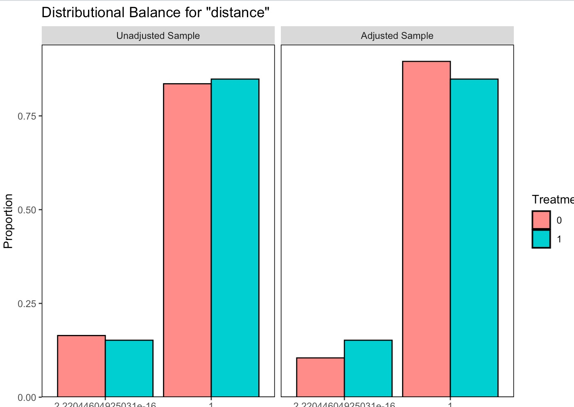
Methodology
Propensity score matching
Ascertained the probability of having chronic diseases based on matching variables
Individual’s propensity score was calculated using the logistic regression model
Common Support Assumption
The assumptions after matching were not satisfied
The distributional balance between the treated & control variables actually got worse after matching.

Slide 9
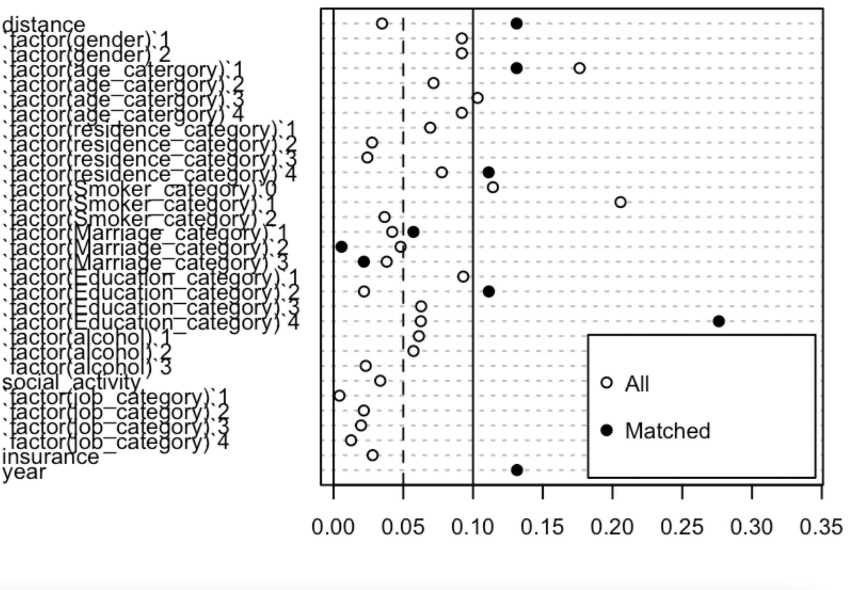
Balance exam for SMD before and after matching

Slide 10
Findings
The impact of having chronic diseases on presenteeism
 | Estimate | SE | T-value | P
cdcount | 5.895 | 9.098 | 0.648 | 0.5171
factor(year)1 | 1.798 | 0.889 | 2.023 | 0.043 *
The impact of having chronic diseases on absenteeism
 | Estimate | SE | T-value | P
cdcount | 0.532 | 0.498 | 1.069 | 0.285
factor(year)1 | 0.056 | 0.049 | 1.147 | 0.251

Slide 11
Discussion
Our results were not not statistically significant (p>0.05)
Matching could not be an optimal method in this study due to the SMD changed, which was a poor matching.
However, this could be because of the way the worker productivity is captured & quantified in the CHARLS dataset which is only in terms of hours per week (presenteeism).
The number of hours might not paint a true picture of the productivity, as some respondents might have reported higher numbers to seem “more productive”
CHARLS does not capture a lot of observations for individuals <45 years, because the survey is targeted mainly towards elderly people
This might have implications on our analysis & results, since a significant chunk of the “productive population” could be <45 years
Furthermore, some NCDs are more long-term conditions whose effect on the worker productivity might be difficult to isolate and study
Other indices and metrics could additionally be used to reflect the work productivity loss

Slide 12
APPENDIX

Slide 13
Balance table before matching
Covariates | N | Mean | SD | N | Mean | SD | N
gender | 1974 | 1.38 | 0.48 | 3235 | 1.35 | 0.48 | F=5.298**
age_catergory | 1974 | 2.51 | 0.89 | 3235 | 2.66 | 0.88 | F=34.527***
residence_category | 1974 | 2.44 | 0.84 | 3235 | 2.47 | 0.83 | F=1.278
Smoker_category | 1974 | 0.91 | 0.95 | 3235 | 0.94 | 0.92 | F=1.445
Marriage_category | 1974 | 2.05 | 0.24 | 3235 | 2.04 | 0.22 | F=1.952
Education_category | 1974 | 2.41 | 0.88 | 3235 | 2.35 | 0.9 | F=5.681**
alcohol | 1974 | 2.1 | 0.94 | 3235 | 2.1 | 0.94 | F=0.042
social_activity | 1974 | 0.59 | 0.49 | 3235 | 0.62 | 0.48 | F=4.204**
job_category | 1974 | 2.09 | 0.72 | 3235 | 2.08 | 0.76 | F=0.453
insurance | 1974 | 0.96 | 0.19 | 3235 | 0.97 | 0.17 | F=2.463

